Slide 1
THE 15 PUZZLE
By Group 9
Notes:
© Copyright PresentationGO.com – Free Templates & Infographics for PowerPoint and Google Slides

Slide 2
INTRODUCTION
The 15 puzzle is a classic AI problem.
Our goal is to solve it automatically using algorithms.
We will show DFS and A* solutions along with animations.

Slide 3
WHAT IS “THE 15 PUZZLE”?
The 15-Puzzle is a 4x4 sliding puzzle with 15 numbered tiles and one blank space.
The objective is to arrange the tiles in order.
We will solve it using Depth-First Search and A* Search algorithms, and we will show animations for each solution.

Slide 4
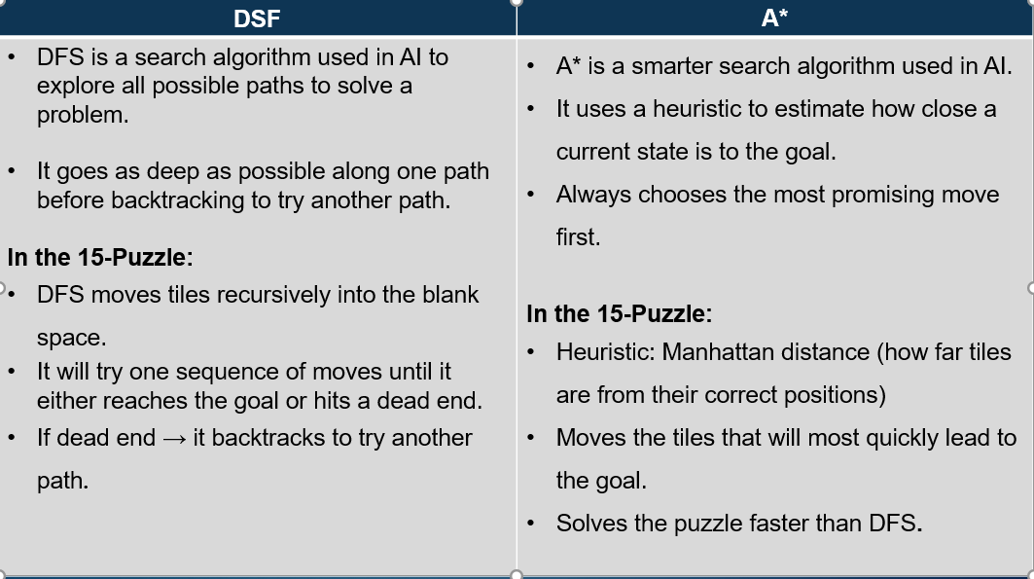

Slide 5
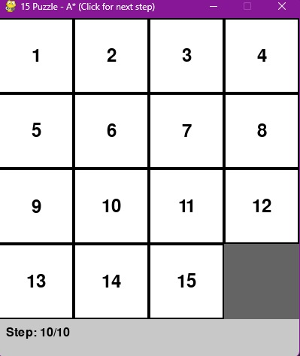
Goal State
What is the Goal State?
The goal state is the correct final arrangement of the puzzle.
All numbered tiles are arranged in ascending order.
The blank space is placed at the bottom-right corner.
Why the Goal State Matters
It defines when the puzzle is solved.
The algorithm continues making moves until this exact arrangement is reached.
Once this state is achieved, the search process stops.

Slide 6
Puzzle Description
The 15-puzzle is a classic problem in Artificial Intelligence used to demonstrate state space search algorithms, such as Depth-First Search (DFS).
The puzzle consists of a 4×4 grid, making a total of 16 positions. Out of these 16 positions:
15 positions contain numbered tiles, from 1 to 15
1 position is empty, called the blank space
This blank space is very important because tiles can only move by sliding into it.
Movement Rules
Only one tile can move at a time
A tile can move only if it is adjacent to the blank space
Adjacent means: Above, Below, Right, left.
Note: Diagonal moves are not allowed
Notes:
© Copyright PresentationGO.com – Free Templates & Infographics for PowerPoint and Google Slides

Slide 7
DFS Initial state
This is Depth First Search, it is a state space search algorithm used in AI to explore possible solutions to a problem by going as deep as possible along one path before backtracking. It explores one branch completely before moving to another.
The tiles should be scrambled, not in order
The blank space should be clearly visible
*This slide shows the initial state of the 15-puzzle before Depth-First Search starts.
The initial state is simply the starting arrangement of the tiles. It is usually random or scrambled and is not yet solved.
At this point:
The goal has not been reached. DFS has not made any moves.
This is where the search algorithm begins its exploration
Notes:
© Copyright PresentationGO.com – Free Templates & Infographics for PowerPoint and Google Slides

Slide 8
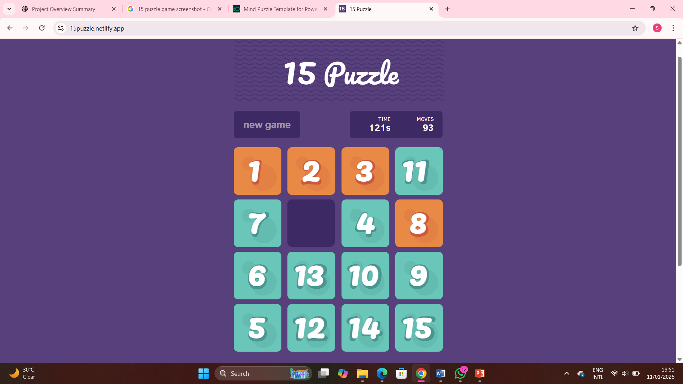
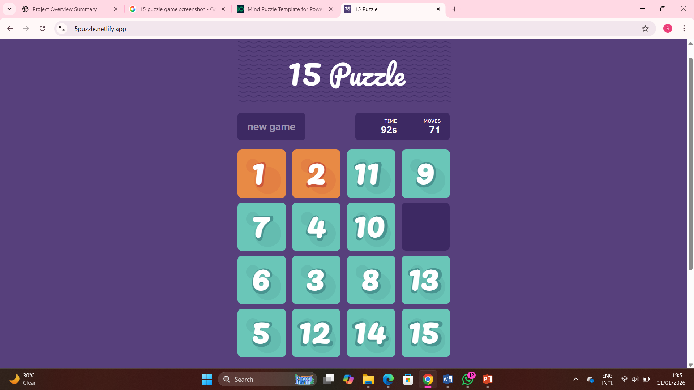
DFS Middle Moves
2. Recursive Path Exploration
• DFS uses recursion to explore the 15-puzzle by treating each move as a new sub-problem.
• Once a move is made (e.g., sliding the 14-tile left), the algorithm immediately calls itself again from that new board configuration.
• It "pushes" each state onto a stack, moving further away from the starting point with every recursive call.
3. Emphasis: "Depth-First" vs. Backtracking
• Commitment to the Path: DFS is designed to explore one branch fully before it even considers other options at the root level.
• Backtracking: The algorithm only "backtracks" (goes back up to a previous board state) if it hits a dead end or a maximum depth limit.
• Middle Move Logic: In these middle steps, DFS isn't looking for the "shortest" path; it is simply trying to see how far down the current "hole" goes to find the goal.

Slide 9
DFS(Depth First Search) Final State

Slide 10
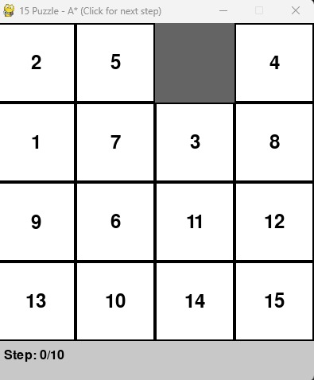
A* Search – Initial State

Slide 11
DFS Complexity
Time complexity O(b^d) Branching factor(b): In a 15-puzzle, this is the number of possible moves from any state (typically between 2 and 4, averaging around 3).
Depth(d): This is the depth of the search. In the worst case, DFS explores every node down to a specified depth limit. Without a limit, it can explore paths much longer than the optimal solution, which can reach up to 80 moves
Space complexity O(b*d)
This complexity accounts for the frontier (the stack of nodes waiting to be explored). For every level d of the search tree, you must store the b children of the current node.
Memory Efficient: Uses linear space O(bd), making it practical for deep searches where | Limited Scaling: Without pruning or depth-limiting, the stack can still grow excessively in unstructured state spaces.
Fast "Lucky" Find: If a solution exists on the first path explored, DFS can find it much faster than BFS. | Time Inefficient: Can waste hours exploring "blind alleys" or deep, unproductive paths that don't lead to the goal.

Slide 12
Depth-First Search (DFS) – Time Complexity
DFS explores one sequence of moves completely before backtracking
It does not check if a move is the best option before continuing
Many incorrect paths may be explored before reaching the goal
Time complexity: O(bᵈ)
b = number of possible moves at each step
d = depth of the solution
As puzzle difficulty increases, solving time also increases

Slide 13
DFS Space Complexity
•DFS stores only the current path being explored
•It does not store all possible puzzle states
•Space complexity: O(b × d)

Slide 14
A* Middle Moves(How A Chooses Its Path)
Unlike DFS, which goes deep down one path, A* is a guided search. It doesn't just try moves at random.
For every possible move, A* calculates a score using this formula:
-f(n) = g(n) + h(n)
-g(n) (Cost So Far): The number of moves already taken from the start to reach this state.
-h(n) (Heuristic - Estimated Cost to Go): An educated guess of the moves needed to reach the goal. We use the Manhattan Distance.
-f(n) (Total Estimated Cost): The sum. A* always expands the state with the lowest f(n) score first.

Slide 15
The Manhattan Distance Heuristic
This is our "educated guess." For each numbered tile:
-Find its current position on the grid.
-Find its goal position.
-Calculate the distance as: |current_row - goal_row| + |current_column - goal_column|
-We add this distance for all 15 tiles. The total gives h(n), an estimate of how many slides are still needed. A lower h(n) means the puzzle looks more "organized."
-We add this distance for all 15 tiles. The total gives h(n), an estimate of how many slides are still needed. A lower h(n) means the puzzle looks more "organized."

Slide 16
Why It's Faster Than DFS:
-Goal-Directed: A* uses the heuristic to prioritize moves that make the puzzle look more like the goal. It's not wandering blindly.
-Efficient Exploration: By always choosing the move with the lowest total estimated cost (f(n)), it focuses its effort on the most promising path, dramatically reducing the number of states it needs to explore compared to DFS.

Slide 17
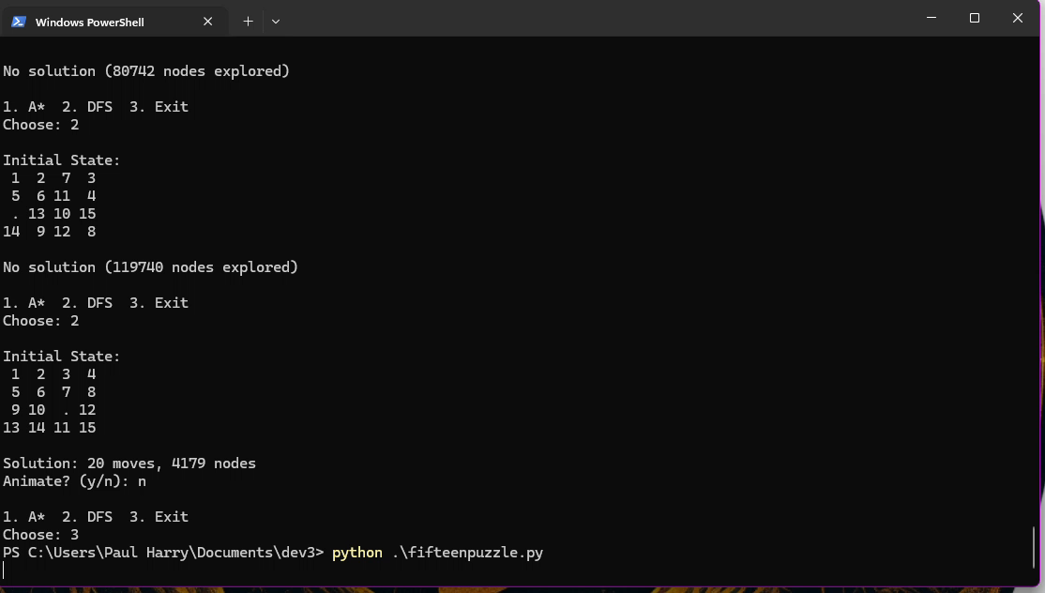
DFS & A* Animations

Slide 18
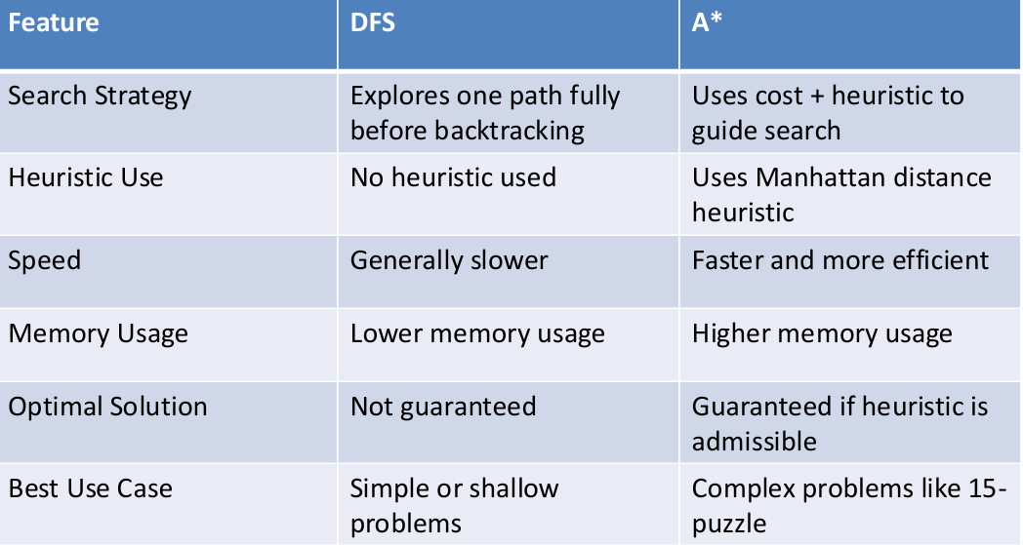
DFS vs A* Comparison
Key Takeaways
• DFS explores blindly without guidance
• A* uses heuristics to make informed decisions
• DFS is memory-efficient but slow
• A* is faster but consumes more memory

Slide 19
The 15 Puzzle Advantages & Limitations
Advantages
• Visual understanding of AI search
• Demonstrates DFS vs. A* strategies
• Animations show step-by-step solving
• Highlights heuristic vs. recursive approaches
• Useful for AI/algorithm teaching
Limitations
• DFS becomes slow with deeper searches
• A* requires more memory storage
• Efficiency depends on heuristic quality
• Not scalable to larger puzzles (e.g., 24-puzzle)
DFS Space Complexity

Slide 20
Conclusion
Both DFS and A* successfully solve the 15-Puzzle
• DFS explores deeply without guidance → slower
• A* uses heuristics → faster & more efficient
• Animations made solving behavior clear
• Demonstrated real AI decision-making
• A* is the more practical method for this puzzle

Slide 21
Thank You!
Notes:
© Copyright PresentationGO.com – Free Templates & Infographics for PowerPoint and Google Slides

